Slide 1
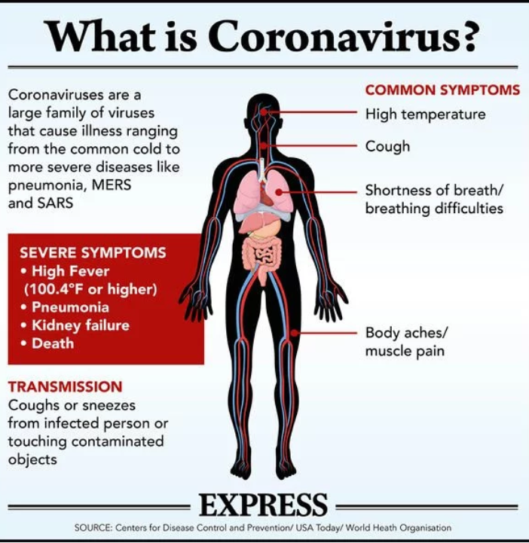
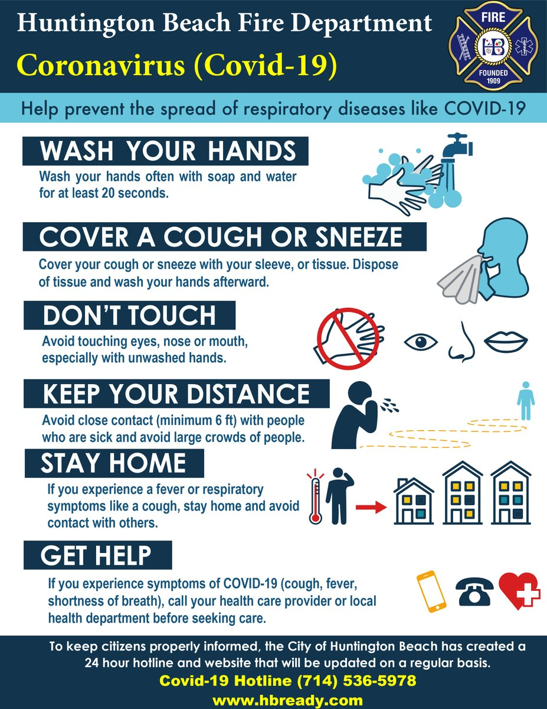
CORONAVIRUS COVID-19
Prepared By- Manisha Gupta, Gunja, Sumanta K Mallik, Neetu Shahi, & Debajit Sarma
ICAR-Directorate of Coldwater Fisheries Research, Bhimtal-263136, Nainital, Uttarakhand

